Slide 1
Analysis of whole-genome sequencing (WGS) data for ten cell lines
Presented to Dr. David Adams, Wellcome Sanger Institute
AccuraScience, LLC
July 7, 2023

Slide 2
Data summary
Whole-genome sequencing (WGS) data for 10 cell lines were received, in BAM format.
In line with preceding discussion with Client, UM_MM66_P6 was not included in the analysis.
Cell line short name | Sample ID | Data file size (GB)
UM_921_P11 | UM_921_P11.sample.dupmarked.bam | 64G
UM_MEL202_P12 | UM_MEL202_P12.sample.dupmarked.bam | 69G
UM_MEL270_P6 | UM_MEL270_P6.sample.dupmarked.bam | 68G
UM_MEL285_P10 | UM_MEL285_P10.sample.dupmarked.bam | 72G
UM_MP38_P6 | UM_MP38_P6.sample.dupmarked.bam | 57G
UM_MP41_P4 | UM_MP41_P4.sample.dupmarked.bam | 70G
UM_MP46_P23 | UM_MP46_P23.sample.dupmarked.bam | 73G
UM_OMM1_P8 | UM_OMM1_P8.sample.dupmarked.bam | 77G
UM_OMM23_P8 | UM_OMM23_P8.sample.dupmarked.bam | 65G
UM_OMM25_P12 | UM_OMM25_P12.sample.dupmarked.bam | 64G
UM_MM66_P6 | UM_MM66_P6.sample.dupmarked.bam | 58G

Slide 3
Analysis procedure
Converting BAM files to FASTQ file format
Samtools (version 1.10) was used to sort BAM files into order by read (query) name for downstream analysis.
Execution command line : samtools sort –n bamfile.bam –o bamfile.sort.bam
Samtools (version 1.10) was used to convert BAM files to FASTQ files.
Execution command line: samtools fastq -@ 16 -1 "filename_1.fastq.gz" -2 "sample_2.fastq.gz" sample.bam
These BAM files received were generated using a strange method adopted by the sequencing lab, leading to difficulty in conversion. Further details discussed in section “Troubleshooting BAM file conversion” (Slide #10).
Quality control (QC)
QC was performed using FastQC (version 0.11.8), and MultiQC (version 1.14) was used to aggregate individual QC report and to compile a general HTML QC report.
Read mapping
Reads were aligned to human reference genome (hg38) using BWA (version 0.7.17), and output SAM files were converted to BAM files using Samtools.
Execution command line: bwa mem -t 64 -R "@RG\tID:sample\tSM:sample\tLB:WGS\tPL:Illumina" genomeIndex sample_1.fq.gz sample_2.fq.gz |samtools sort -@ 64 -o sample.bam -

Slide 4
Analysis procedure, cont’d
Identification of germline short variants (SNPs and InDels)
GATK (version 4.4.0.0) was used for germline short variant calling.
Resource files for germline short variant discovery were download from https://console.cloud.google.com/storage/browser/genomics-public-data/resources/broad/hg38/v0/, including Homo_sapiens_assembly38.dbsnp138.vcf, Mills_and_1000G_gold_standard.indels.hg38.vcf.gz, hapmap_3.3.hg38.vcf.gz, 1000G_omni2.5.hg38.vcf.gz and 1000G_phase1.snps.high_confidence.hg38.vcf.gz.
Marking duplicates for aligned BAM files
Execution command line: gatk MarkDuplicates –I sample.bam –O sample_marked.bam -M sample.metrics
Recalibrating base quality score for BAM files
Execution command line: gatk BaseRecalibrator -R $ref -I sample_marked.bam --known-sites Homo_sapiens_assembly38.dbsnp138.vcf --known-sites Mills_and_1000G_gold_standard.indels.hg38.vcf.gz –O sample_recal.table
gatk ApplyBQSR -R $ref -I sample_marked_fixed.bam -bqsr sample_recal.table -O sample_bqsr.bam
Variant calling
Execution command line: gatk HaplotypeCaller -R $ref -I sample_bqsr.bam –O sample.vcf.gz

Slide 5
Analysis procedure, cont’d
Variant Quality Score Recalibration (VQSR) was performed according to the instructions provided by GATK (https://gatk.broadinstitute.org/hc/en-us/articles/360035531112--How-to-Filter-variants-either-with-VQSR-or-by-hard-filtering ),
Execution command line (for InDels):
gatk VariantRecalibrator -R $ref -V sample.indel.vcf.gz --trust-all-polymorphic -tranche 100.0 -tranche 99.95 -tranche 99.9 -tranche 99.5 -tranche 99.0 -tranche 97.0 -tranche 96.0 -tranche 95.0 -tranche 94.0 -tranche 93.5 -tranche 93.0 -tranche 92.0 -tranche 91.0 -tranche 90.0 --an FS -an ReadPosRankSum -an MQRankSum -an QD -an SOR -an DP mode INDEL --max-gaussians 4 -resource:mills,known=false,training=true,truth=true,prior=12.0 Mills_and_1000G_gold_standard.indels.hg38.vcf.gz -resource:axiomPoly,known=false,training=true,truth=false,prior=10.0 Axiom_Exome_Plus.genotypes.all_populations.poly.hg38.vcf.gz -resource:dbsnp,known=true,training=false,truth=false,prior=2.0 Homo_sapiens_assembly38.dbsnp138.vcf -O sample_indels.recal --tranches-file sample_indels.tranches (Step one)
gatk ApplyVQSR -R /8T3/genome/Homo_sapiens_assembly38.fasta -V sample.indel.vcf.gz --recal-file sample_indels.recal --tranches-file sample_indels.tranches --truth-sensitivity-filter-level 99.7 --create-output-variant-index true -mode INDEL -O sample.filter.indel.vcf.gz (Step two)

Slide 6
Analysis procedure, cont’d
Execution command line (for SNPs):
gatk VariantRecalibrator -R /8T3/genome/Homo_sapiens_assembly38.fasta –V sample.snp.vcf.gz --trust-all-polymorphic -tranche 100.0 -tranche 99.95 -tranche 99.9 -tranche 99.8 -tranche 99.6 -tranche 99.5 -tranche 99.4 -tranche 99.3 -tranche 99.0 -tranche 98.0 -tranche 97.0 -tranche 90.0 -an QD -an MQRankSum -an ReadPosRankSum -an FS -an MQ -an SOR -an DP -mode SNP --max-gaussians 6 -resource:hapmap,known=false,training=true,truth=true,prior=15 hapmap_3.3.hg38.vcf.gz -resource:omni,known=false,training=true,truth=true,prior=12 1000G_omni2.5.hg38.vcf.gz -resource:1000G,known=false,training=true,truth=false,prior=10 1000G_phase1.snps.high_confidence.hg38.vcf.gz -resource:dbsnp,known=true,training=false,truth=false,prior=7 Homo_sapiens_assembly38.dbsnp138.vcf -O sample_snps.recal --tranches-file sample_snps.tranches (Step one)
gatk ApplyVQSR -R Homo_sapiens_assembly38.fasta -V sample.snp.vcf.gz --recal-file sample_snps.recal --tranches-file sample_snps.tranches --truth-sensitivity-filter-level 99.7 --create-output-variant-index true -mode SNP -O sample.filter.snp.vcf.gz (Step two)

Slide 7
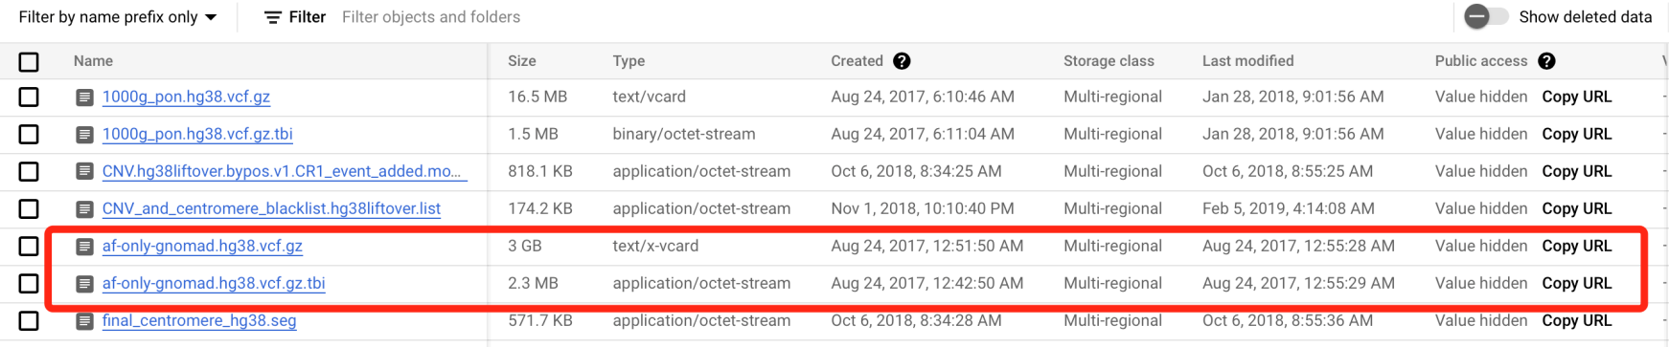
Analysis procedure, cont’d
Removing common variants documented in gnomAD.
gnomAD data was downloaded from GATK bucket (filename af-only-gnomad.hg38.vcf.gz). This file contained allele frequency (AF) information ( https://console.cloud.google.com/storage/browser/gatk-best-practices/somatic-hg38;tab=objects?prefix=&forceOnObjectsSortingFiltering=false ).
af-only-gnomad.hg38.vcf.gz had the following format: AF : allele frequency.
Sites with AF greater than 0.01 were removed from variants identified using bcftools.

Slide 8
Analysis procedure, cont’d
Annotating SNPs and InDels
ANNOVAR (https://annovar.openbioinformatics.org/en/latest/) was used to predict the effect or function of SNPs and InDels.
Identification of structural variants (SVs) using LUMPY
Samtools was used to extract the discordant paired-end alignments and split-read alignments.
Execution command line: samtools view -b -F 1294 sample.bam > sample.discordants.unsorted.bam.
samtools view -h sample.bam | scripts/extractSplitReads_BwaMem –i stdin| samtools view -Sb - > sample.splitters.unsorted.bam
samtools sort sample.discordants.unsorted.bam sample.discordants
samtools sort sample.splitters.unsorted.bam sample.splitters
LUMPY was used for SV identification
Execution command line: lumpyexpress -B UM_921_P11.bam -S UM_921_P11.splitters.bam –D UM_921_P11.discordants.bam -o multi_sample.vcf
Main reference: Comprehensive evaluation and characterization of short read general-purpose structural variant calling software (https://www.nature.com/articles/s41467-019-11146-4).

Slide 9
Analysis procedure, cont’d
Identification of structural variants (SVs) using GRIDSS
Execution command line: gridss-r Homo_sapiens_assembly38.fasta -j gridss-2.13.2-gridss-jar-with-dependencies.jar -o sample.vcf -b ENCFF356LFX.bed sample1.bam sample2.bam
Main reference: Comprehensive evaluation and characterization of short read general-purpose structural variant calling software (https://www.nature.com/articles/s41467-019-11146-4).
Circos plots were generated in R (version 4.1.1) with StructuralVariantAnnotation (version 1.10.1 ), VariantAnnotation (version 1.40.0) and circlize (version 0.4.15) packages.
For results produced by GATK:
The SNP showed in the diagram were limited to the exonic regions and were classified as synonymous and nonsynonymous mutations (annotated by annovar).
The diagram showed InDels located in exonic regions only.
For results produced by LUMPY :
Mutations were classified into four types based on the SVTYPE indicated in the VCF file, namely duplications (DUP), deletions (DEL), inversions (INV), and translocations (BND).
For results produced by GRIDSS:
Mutations were classified into five types using GRIDSS's author code posted on Github (https://github.com/PapenfussLab/gridss/blob/7b1fedfed32af9e03ed5c6863d368a821a4c699f/example/simple-event-annotation.R#L9), namely duplications (DUP), deletions (DEL), inversions (INV), chromosomal translocation (CTX).

Slide 10
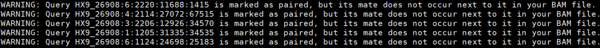
Troubleshooting BAM file conversion
Initially, we converted the BAM files into FASTQ using the standard method, assuming the sequencing lab generated the BAM files from the FASTQ files using a standard method.
Execution command line: samtools fastq -@ 16 -1 "filename_1.fastq.gz" -2 "sample_2.fastq.gz" sample.bam
Subsequent analysis was conducted, including QC, GATK, gnomAD filtering, GRIDSS and LUMPY analysis.
LUMPY generated very few variants, prompting us to troubleshoot each step of the analysis.
During troubleshooting, we discovered that most of the reads were single-ended:
bam2fq reports (for sample UM_921_P11):
Samtools reports (for sample UM_921_P11):
This explains the failure of LUMPY, as SV identification tools heavily rely on pair-ended information in their SV identification algorithms.

Slide 11
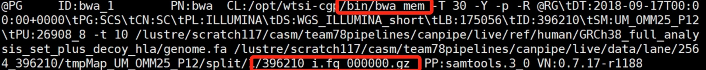
Troubleshooting BAM file conversion, cont’d
Subsequently, we examination the BAM generation log info to try to find out how the BAM files were generated, and discovered that they were generated in an unconventional manner:
First, only one FASTQ file was used to generate a piecemeal BAM file:
Next, several piecemeal BAM files were merged using BAMmerge:
It is unclear why the sequencing lab generated the BAM files in this manner.
Based on this information, we revised the BAM to FASTQ conversion procedure (described in Slide #3), and regenerated pair-ended FASTQ files successfully.
This led to substantial delay in the completion of the project.

Slide 12
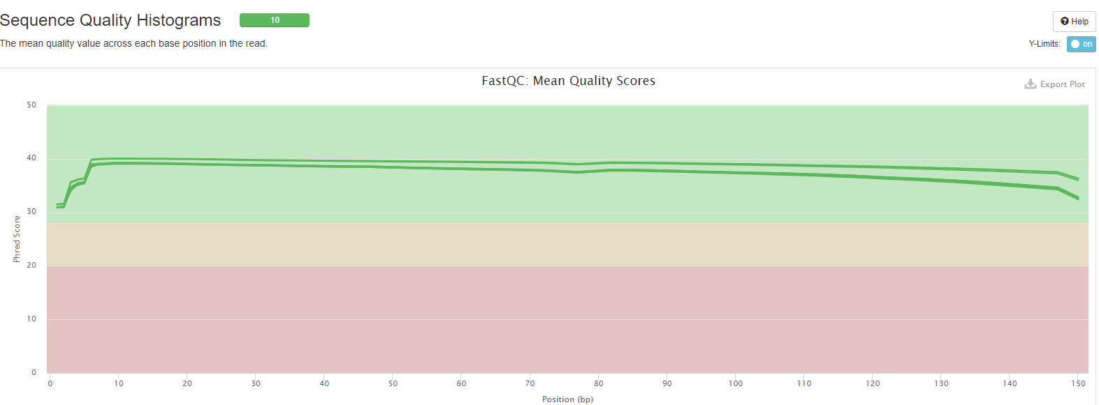
Data quality control (QC)
QC suggested that the data were of good quality and suitable for subsequent analysis:
Per-base quality score distribution:
Complete HTML-format QC report is included in Supplementary folder.

Slide 13
Variants identified
Summary of numbers of variants identified for each of the 3 tools for each of the 10 cell lines:
Cell line short name | GATK |  |  |  | LUMPY | GRIDSS
 | SNPs | SNPs (following AF filtering based on gnomAD) | InDels | InDels following AF filtering based on gnomAD)
UM_921_P11 | 4072056 | 289647 | 957131 | 143081 | 16917 | 93776
UM_MEL202_P12 | 3946274 | 290074 | 945580 | 144985 | 17262 | 97675
UM_MEL270_P6 | 3952138 | 291463 | 955568 | 150630 | 16688 | 99857
UM_MEL285_P10 | 3728814 | 281771 | 924516 | 146902 | 18138 | 98349
UM_MP38_P6 | 3901871 | 271197 | 919824 | 132751 | 14938 | 89114
UM_MP41_P4 | 3947068 | 329559 | 1344378 | 628822 | 17166 | 98438
UM_MP46_P23 | 3721387 | 287052 | 921143 | 148888 | 17808 | 94698
UM_OMM1_P8 | 3769459 | 312166 | 927095 | 149727 | 17968 | 97215
UM_OMM23_P8 | 3607373 | 270349 | 898780 | 144126 | 16363 | 92204
UM_OMM25_P12 | 3629769 | 271169 | 890765 | 137183 | 15419 | 90102

Slide 14
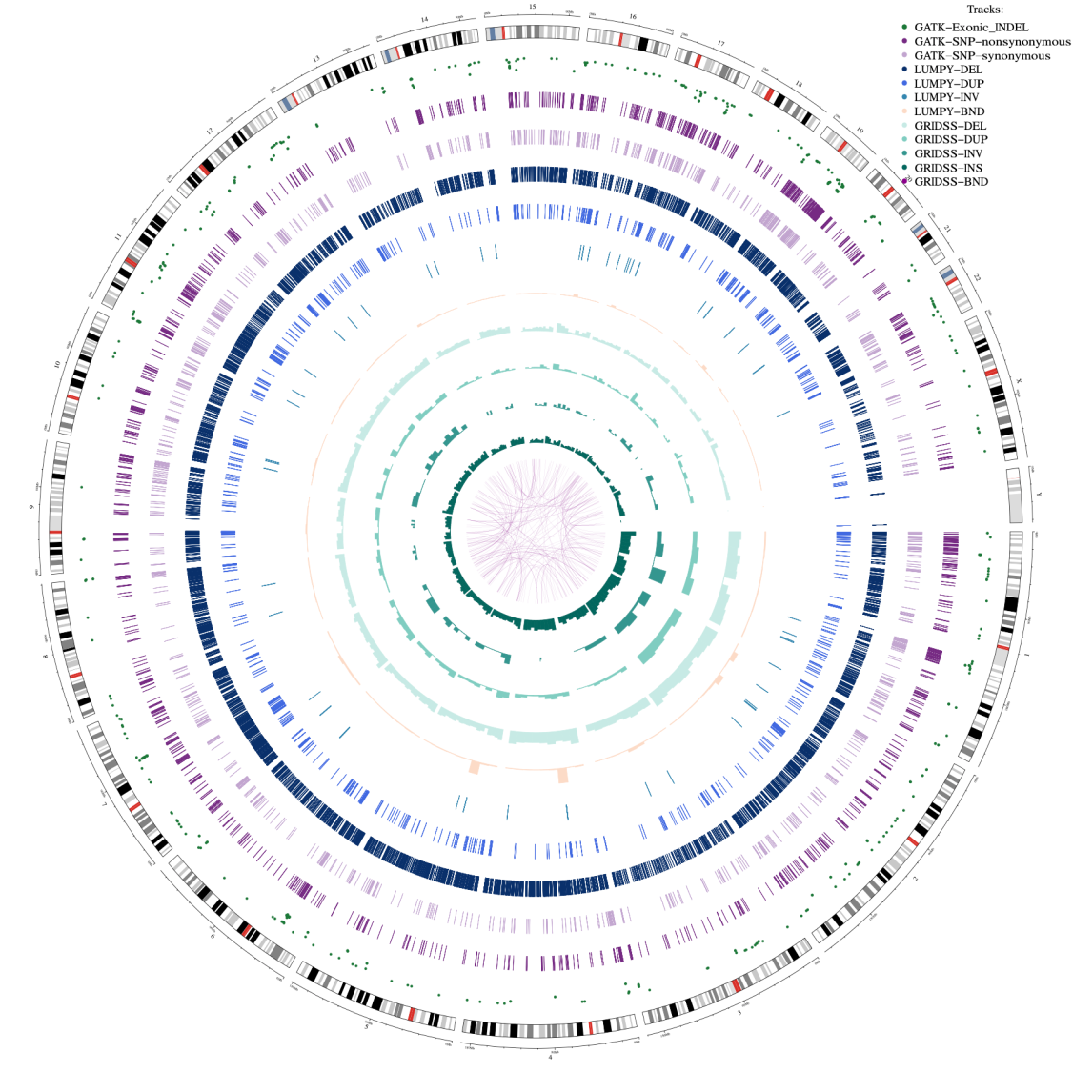
Circos plot generation
We attempted to generate circos plots that includes variant information per Client’s instructions.
However, we found that the plots became over-crowded if we included homozygous/heterozygous information for SNPs as Client suggested. For now, we only include synonymous and non-synonymous variant information within exonic regions for SNPs. Homozygous/heterozygous information has been included in the INFO column in the VCF files included in the Supplementary folder.
We have generated circos plots for two cell lines for now. UM_MP38_P6 (current slide) and UM_MP41_P4 (next slide). Circos plots for the other 8 cell lines will be generated after the settings of the plots are decided.
If displaying homozygous/heterozygous information is desired, we recommend further filtering of the variants to be conducted.

Slide 15
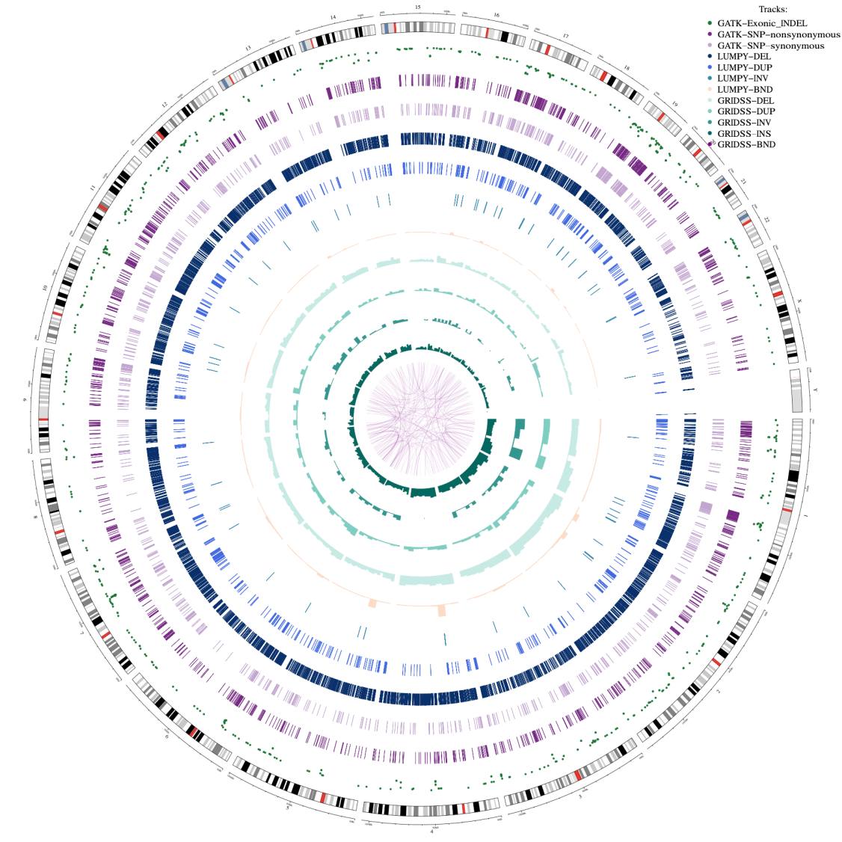
Circos plot for cell line UM_MP41_P4
Circos plot for cell line UM_MP41_P4 is presented.

Slide 16
Result files included in supplementary folder
Detailed results of mutations in VCF format and figures are in Supplementary folder.
multiqc_report.html: QC report.
Figures
Figures/GATK/SNP: Figures for density of SNPs across chromosomes within 5Mb windows.
Figures/GATK/INDEL : Figures for density of INDELs across chromosomes within 5Mb windows.
Figures/LUMPY : Figures for the percentage of different mutation types identified by LUMPY.
Figures/GRIDSS : Figures for the percentage of different mutation types identified by GRIDSS.
Figures/Circos_figures : Circos plots for cell lines.
VCFfiles
VCFfiles/GATK :
VCFfiles/GATK/AnnotatedVCF: The VCF file has been filtered using gnomAD data and annotated using ANNOVAR.
VCFfiles/GATK/RawVCF: GATK VCF files without any filtering.
VCFfiles/GRIDSS: The results of GRIDSS are saved in GRIDSS folder.
The raw VCF files outputted by GRIDSS are stored in the RawVCF folder with the naming pattern{cell line}.vcf
The VCF files annotated by the GRIDSS author's code is located in the AnnotatedVCF folder with the naming pattern{cell line}.vcf_sv.annotated.vcf.
VCFfiles/ LUMPY : The results of LUMPY are saved in LUMPY folder and follow the naming pattern of {cell line}.vcf

